Slide 1
Chocoholics Anonymous
SMARAN AERRAMSETTY
VINAY DATTA PINNAKA
VENKATAMANTHENA

Slide 2
USE CASES IMPLEMENTED

Slide 3
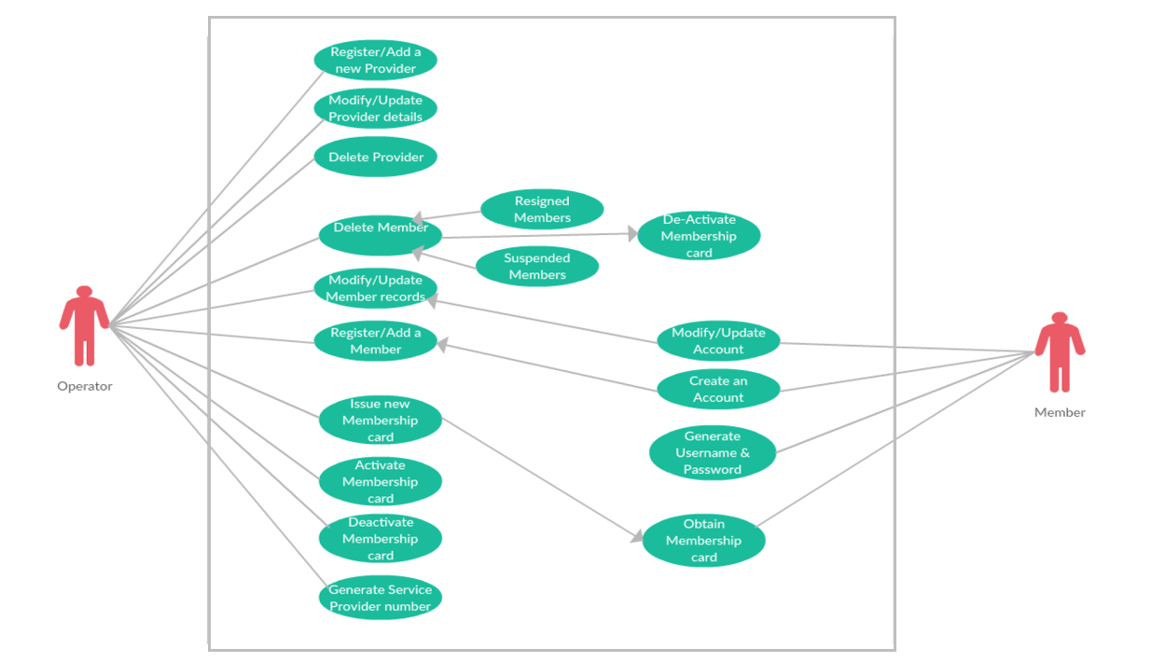

Slide 4
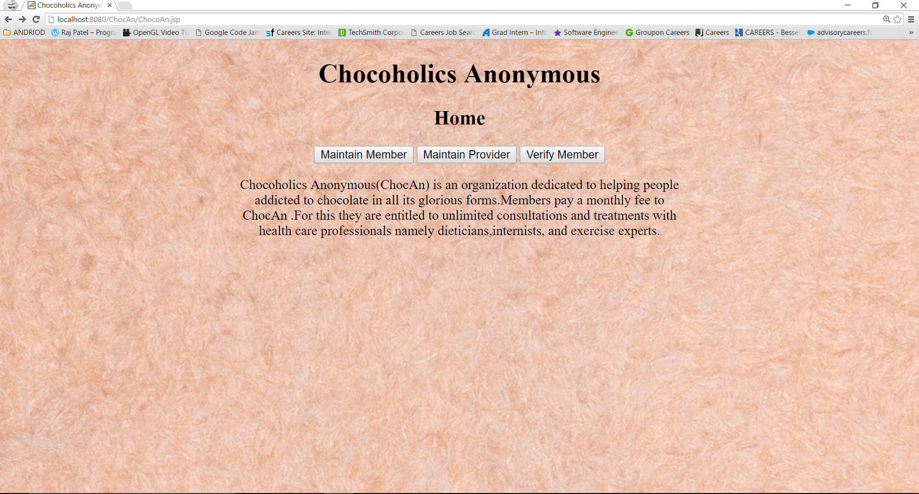
IMPLEMENTATION
Back-end
Front-End
Local MySQL Database

Slide 5
CLASS HIERARCHY
Manage Member
Add Member
Update Member
Delete Member

Slide 6
CLASS HIERARCHY
Manage Provider
Add Provider
Update Provider
Delete Provider

Slide 7
CLASS HIERARCHY
Manage Database
Member Summary
Provider Summary

Slide 8
Product Developed using
Eclipse Java EE
MySQL Community Server Ver. 5.7
Tomcat 8.0

Slide 9
Screenshots

Slide 11
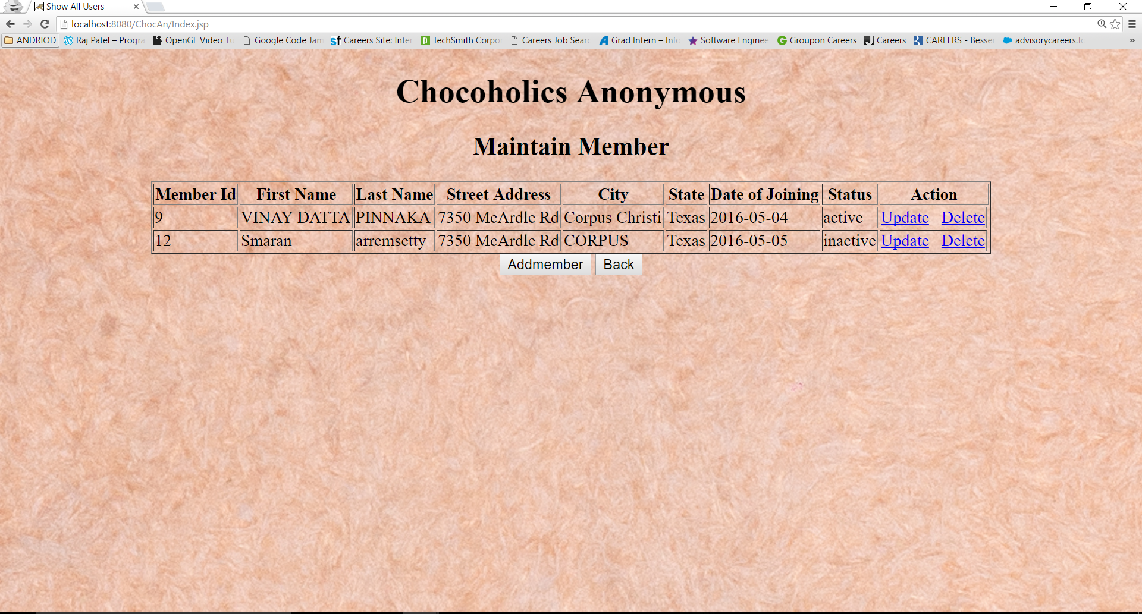

Slide 12
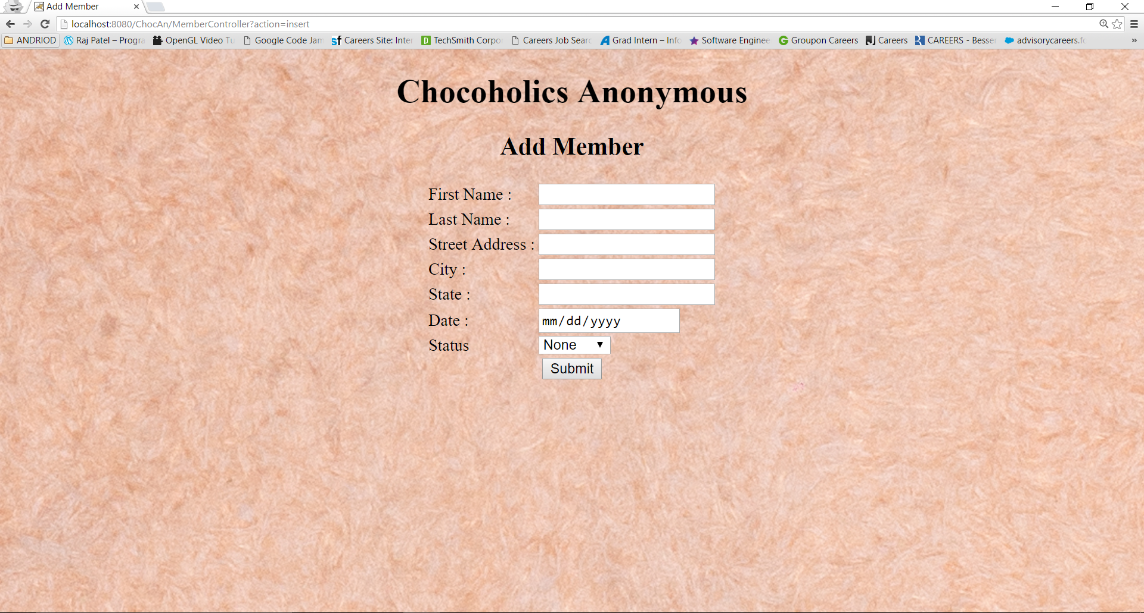

Slide 13
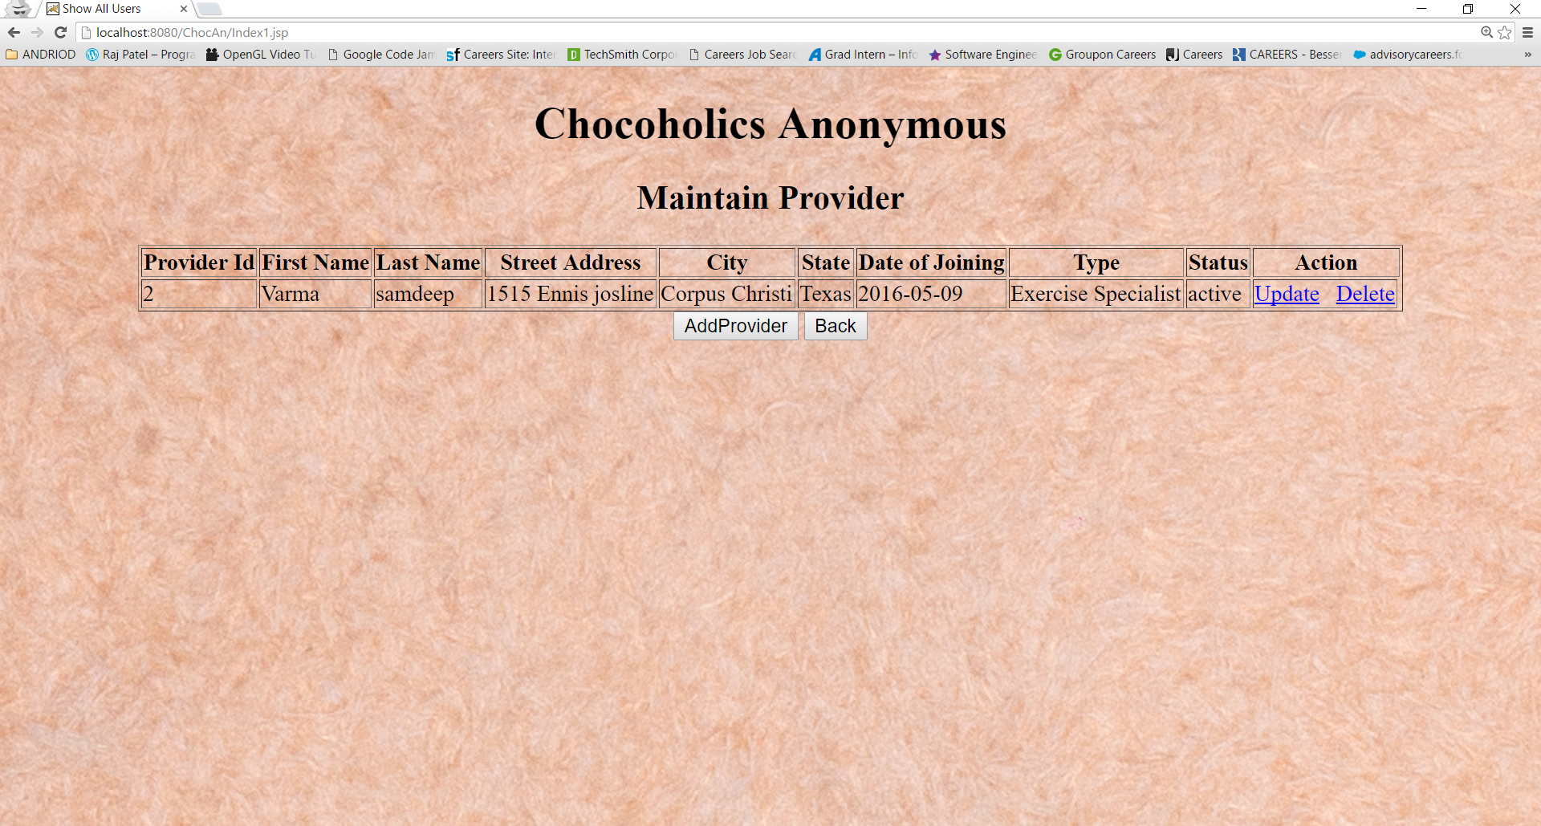

Slide 14
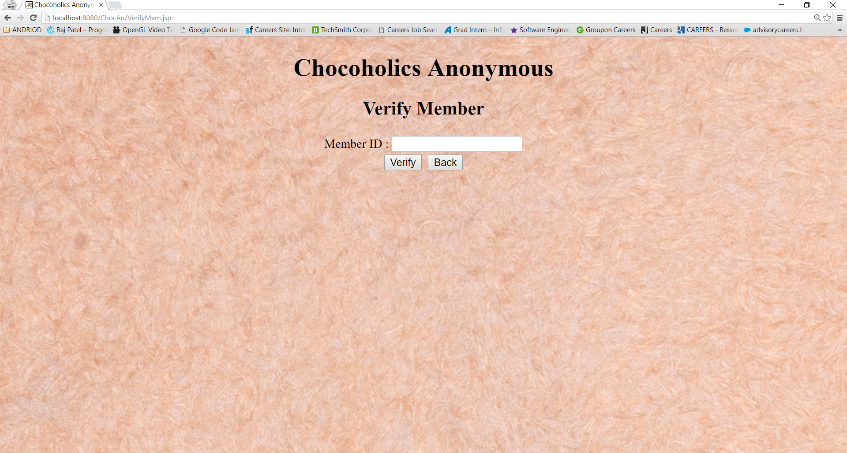
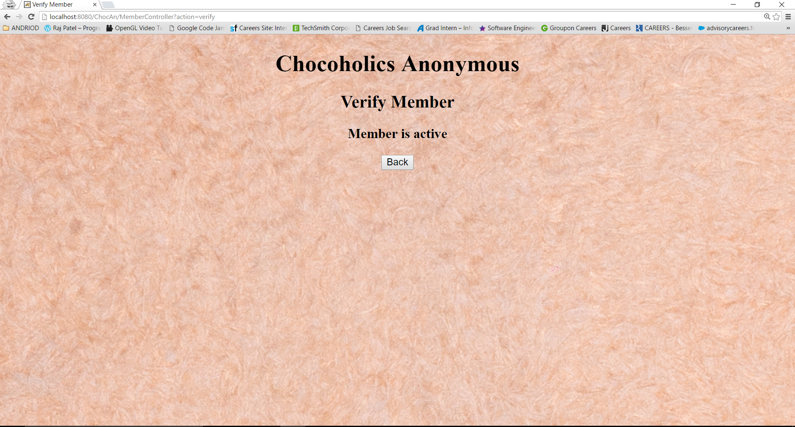

Slide 15


